Slide 1
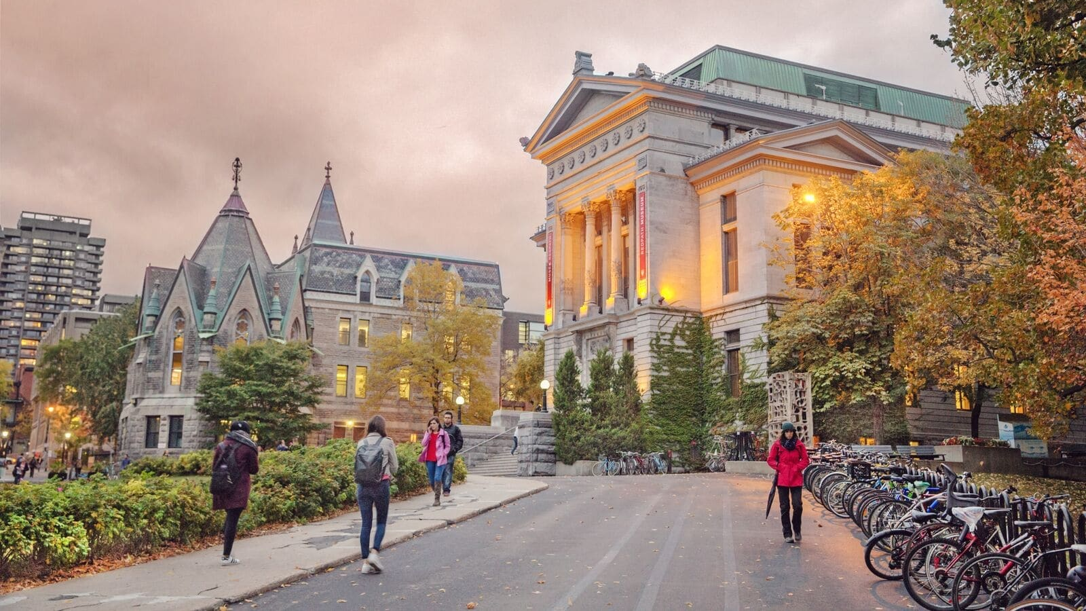
McGillUNIVERSITY
PETER GUO-HUA FU SCHOOL OF ARCHITECTURE
Master of Architecture (M.Arch.) Professional (Non-Thesis)
Sherbrooke Street West, Montréal, Québec, Canada
Presentation by Nida Hameed
Notes:
Located in Montreal Quebec
2 year – non thesis program
About 50 students per year/ so 100 for all masters
Best part about uni is that its In Montreal – lots of frestivals opens streets etc,
You don’t need to know French to attend the school

Slide 2
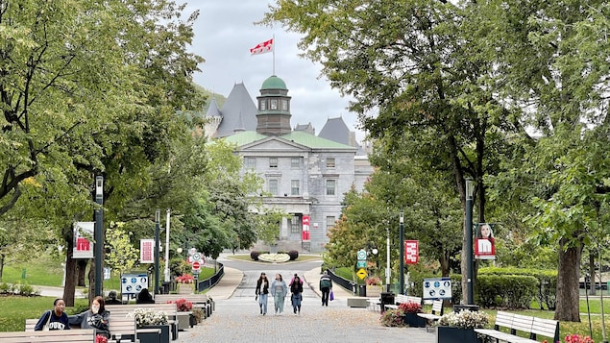
Application
The deadline for submission of your online application and all supporting documents is December 15.
Notes:
CV, Transcripts, Electronic letters of reference, Completed program chart, Course descriptions, Proof of English language proficiency, e-portfolio

Slide 3
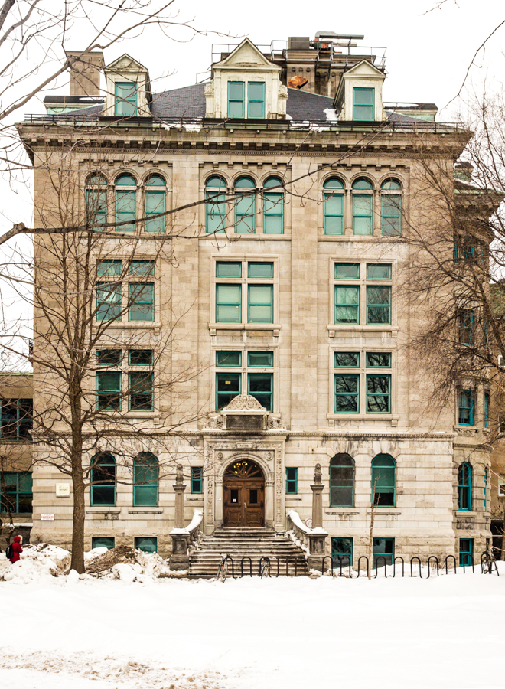
Program/Costs
NON-THESIS PROGRAM
Year 1
1st Term/ Fall
  Studio – 9 Credits
  Mandatory course- 3 Credits
  One Complementary – 3 Credits
  Subtotal: 15 Credits
2nd Term/ Winter
  Studio – 9 Credits
  Two Complementary – 3 Credits Each
  Subtotal: 15 Credits

Slide 4
Program/Costs
NON-THESIS PROGRAM
Year 2
1st Term/ Fall
  Thesis Project – 9 Credits
  Two Complementary – 3 Credits Each
  Subtotal: 15 Credits
2nd Term/ Winter
  Thesis Project – 9 Credits
  Mandatory course- 3 Credits
  One Complementary – 3 Credits
  Subtotal: 15 Credits

Slide 5
Program/Costs
NON-THESIS PROGRAM
Credit Based
Each term = 15 Credits
Total - $1483.65 / $98.9 Per Credit
  Québec Students
  2 Year Total: $5934.6
Total - $6180 / $412 Per Credit
  Non- Québec Canadian Students
  2 Year Total: $24,720
Total - $13,840 / $922.67 Per Credit
  International Students
  2 Year Total: $55,360

Slide 6
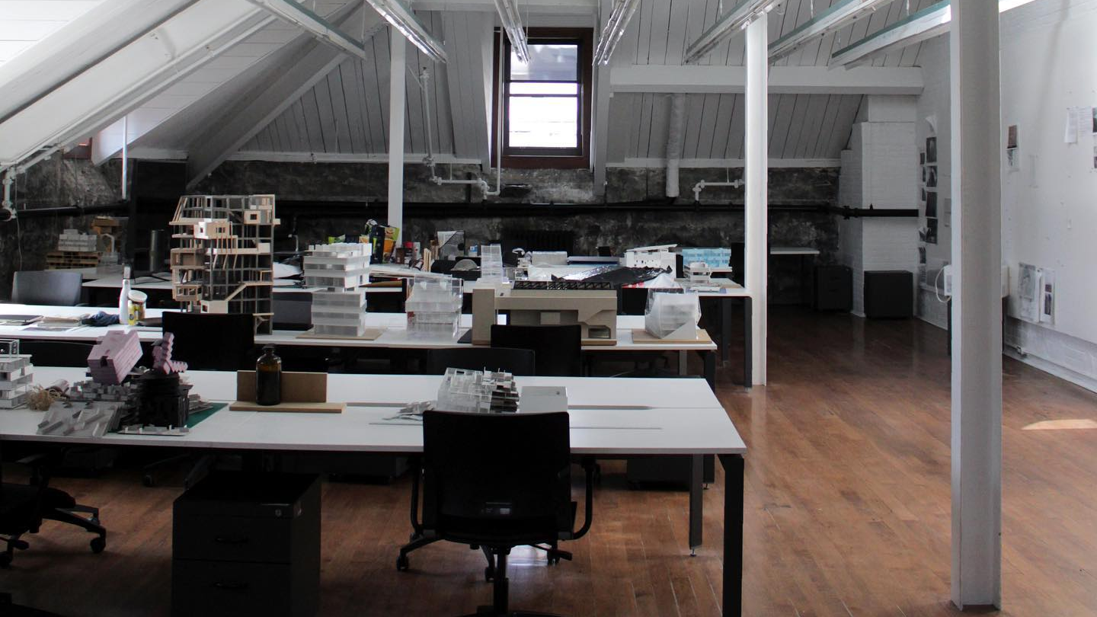
Mentor/Advisor Pairing
Healthcare
Urban Planning
Adaptive Reuse
Sustainable Residential Development
Art + Architecture
Etc….
Notes:
Micheal – 15 students
Most profs take 1-2 students

Slide 7
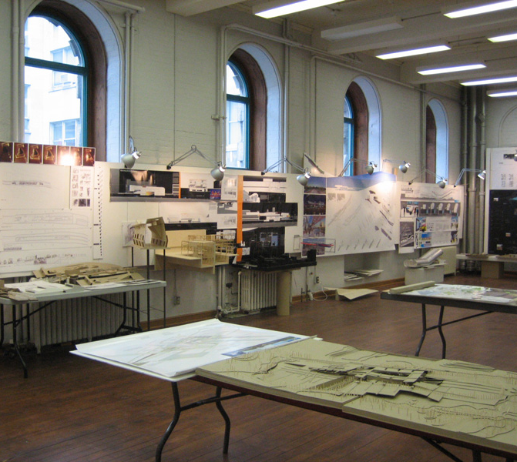
Scholarships
McCall McBain
NSERC/SHERC
Bourses universitaire de l’OAQ
The Bruce Anderson Travel Award in Architecture
Dr. Soo Kim Lan Prize in Architecture
RIBA Norman Foster Travelling Scholarship
Vince Catalli Scholarship for Sustainable
Architectural Innovation
A. F. DUNLOP SCHOLARSHIPS – 2023/2024
The John Bland Scholarship

Slide 8
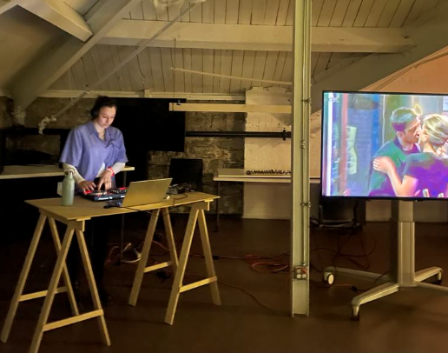
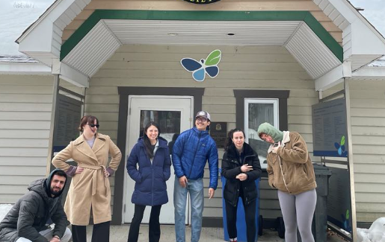
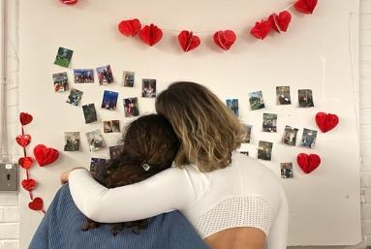
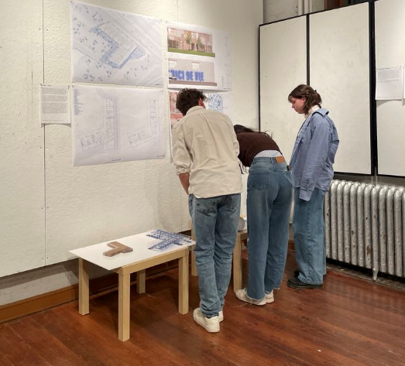
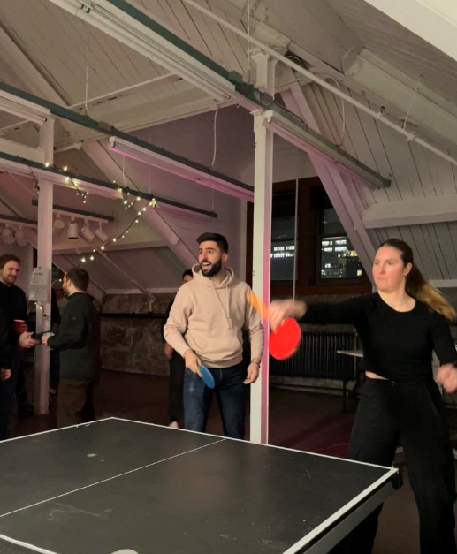
GASA
Tournaments
Late Nights
Cabin Trip
Picture Wall
Networking Events
Etc…

Slide 9

Contacts
hajara.hameed@mail.mcgill.ca
marcia.king@mcgill.ca
gasa.pgss@mail.mcgill.ca
Notes:
Pgss email
Gasa

