Slide 1

Presented by: gwen del rosario
7 Melville St S, Cambridge,
Ontario, Canada N1S 2H4
(519) 888-4567 ext. 27602
archgradoffice@uwaterloo.ca
University of waterloo
school of architecture

Slide 2
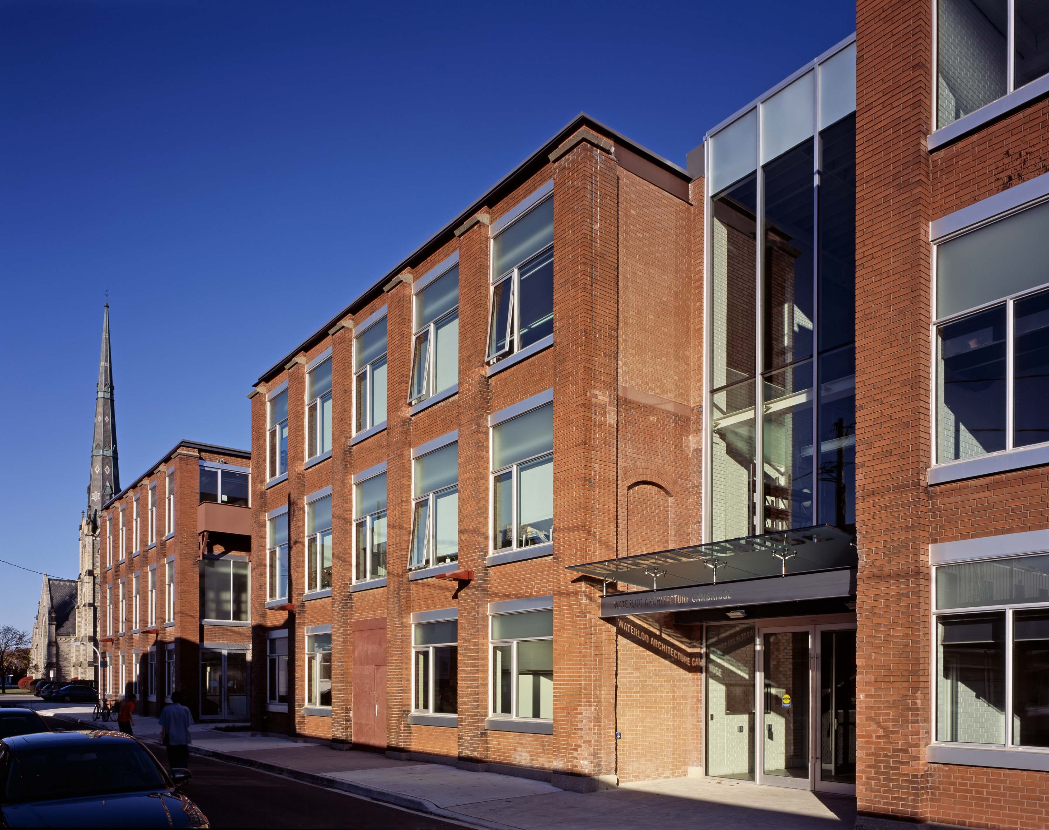
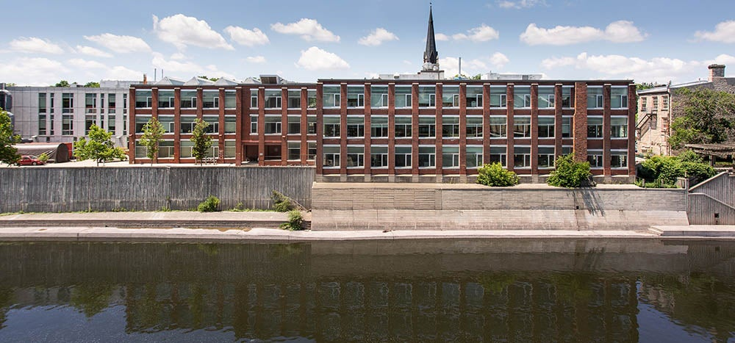
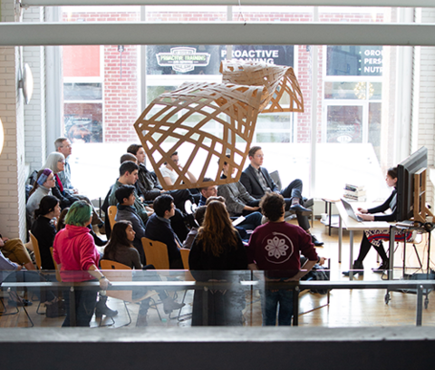
University of Waterloo School of Architecture (UWSA)
Location: Cambridge, Ontario
The school is located on the traditional territory of the Neutral, Anishinaabeg and Haudenosaunee peoples. It is also situated on the Haldimand Tract, the land promised to the Six Nations which includes 10 kilometres on each side of the Grand River.

Slide 3

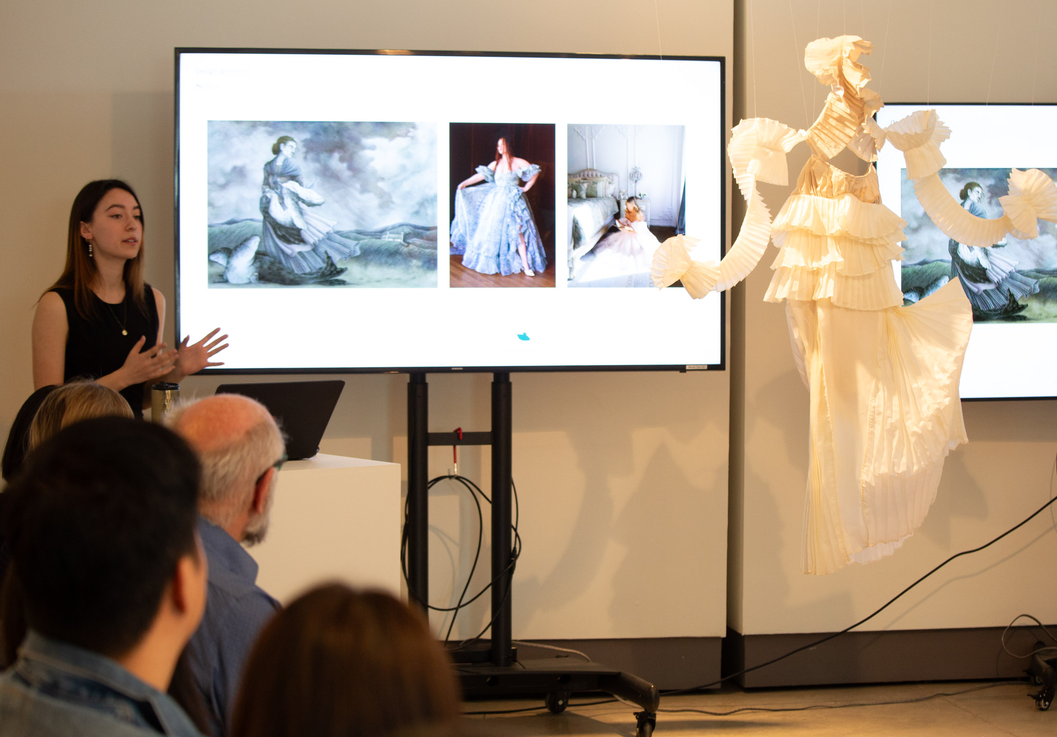
University of Waterloo School of Architecture's MArch program
Degree Type: Master of Architecture (MArch)
Duration: 2 years
Granted accreditation by CACB for 6-year term in 2017. Scheduled for review of accreditation status in 2024. GRANTED AGAIN AS OF JULY 1, 2024! 6-year term now ends in 2030
Program offers an extension of pre-professional undergraduate experience in architecture
Traditional coursework into research thesis program
Water Program and Structures Certificate – optional interdisciplinary program
Similar offerings from the school's Bachelor of Architectural Studies program apply to the Master of Architecture program
  Co-op opportunities
  International research travel
  Optional term in Rome

Slide 4
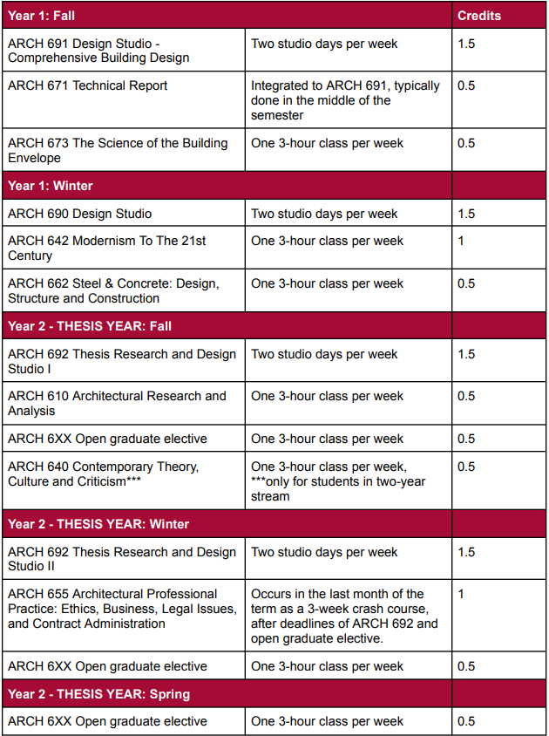
MArch Schedule at a Glance...
1st Year
Fall
Three courses, including studio
One of the course (ARCH 671) is ties into the term's studio, effectively resulting in two active courses for the term (more weekdays off)
Winter
Three courses
Spring
Optional co-op term

Slide 5
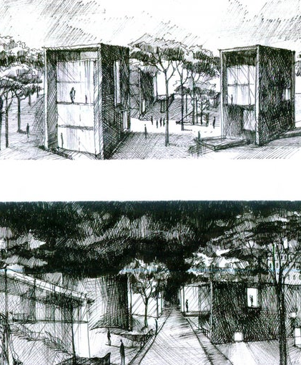
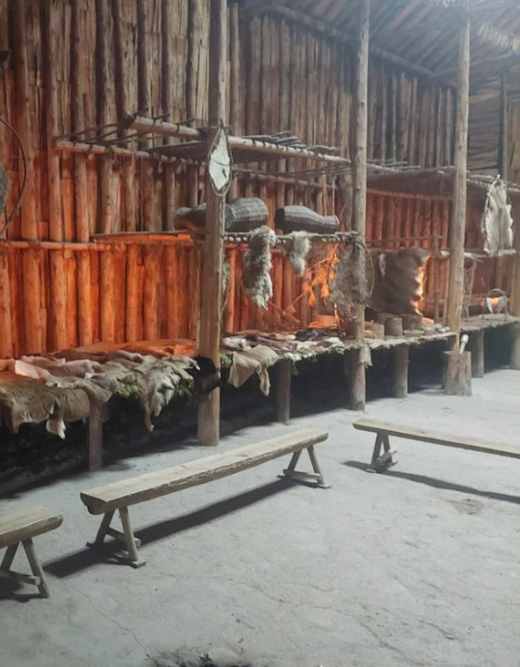
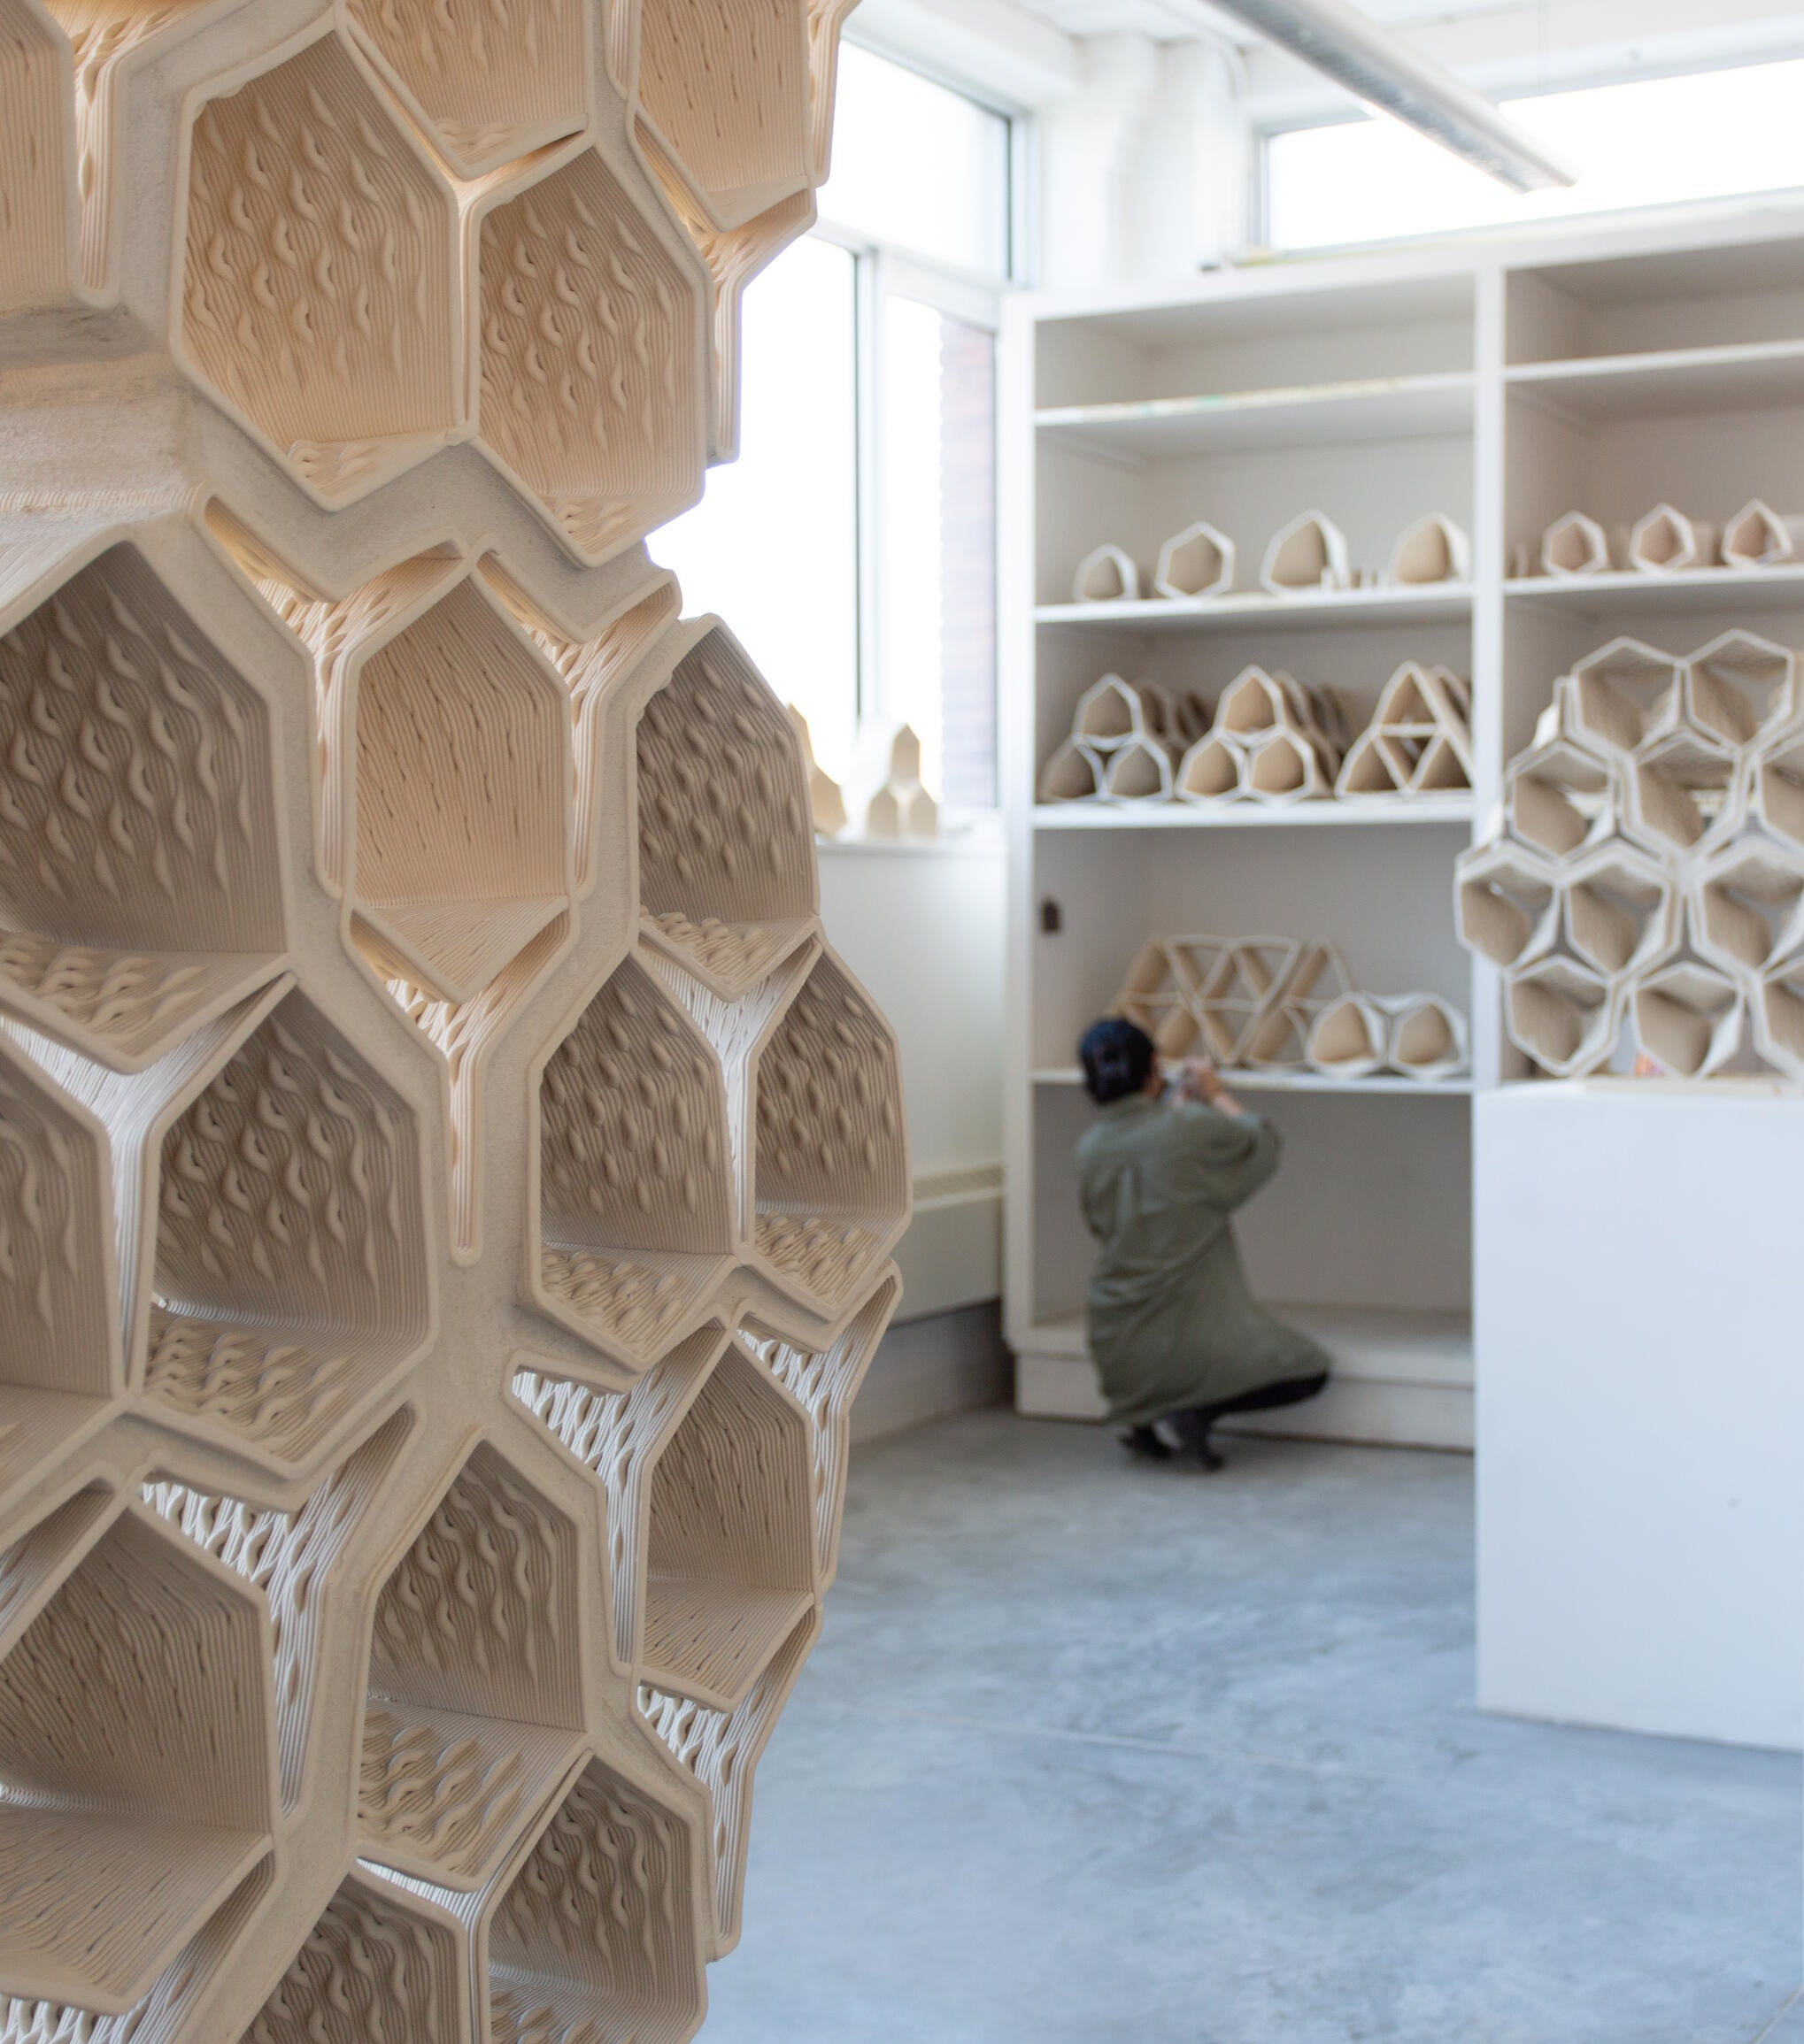
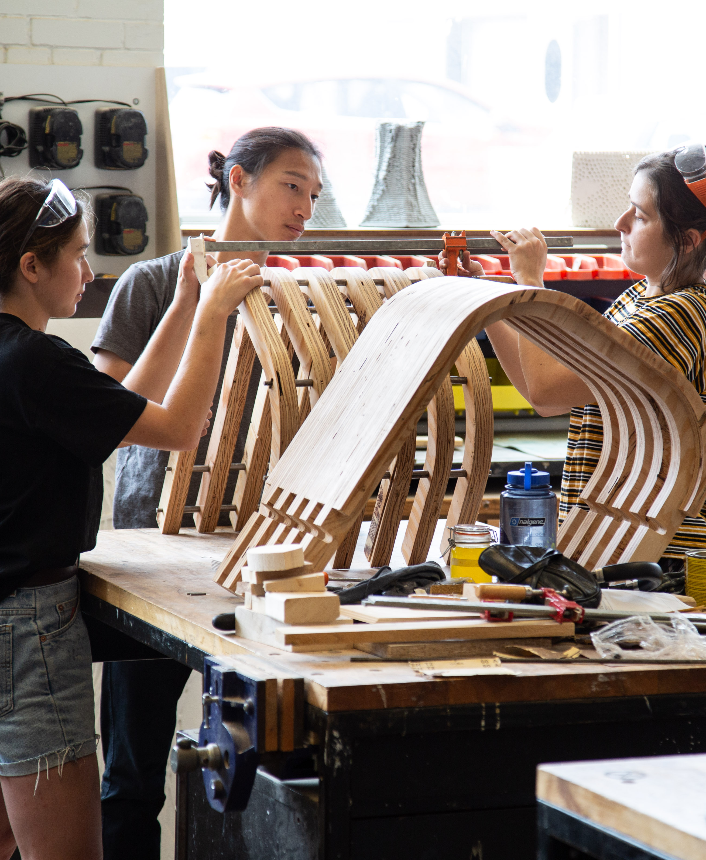
Architectural Courses
Theory
Cultural and Indigenous History
Digital Fabrication
Craft and Construction

Slide 6
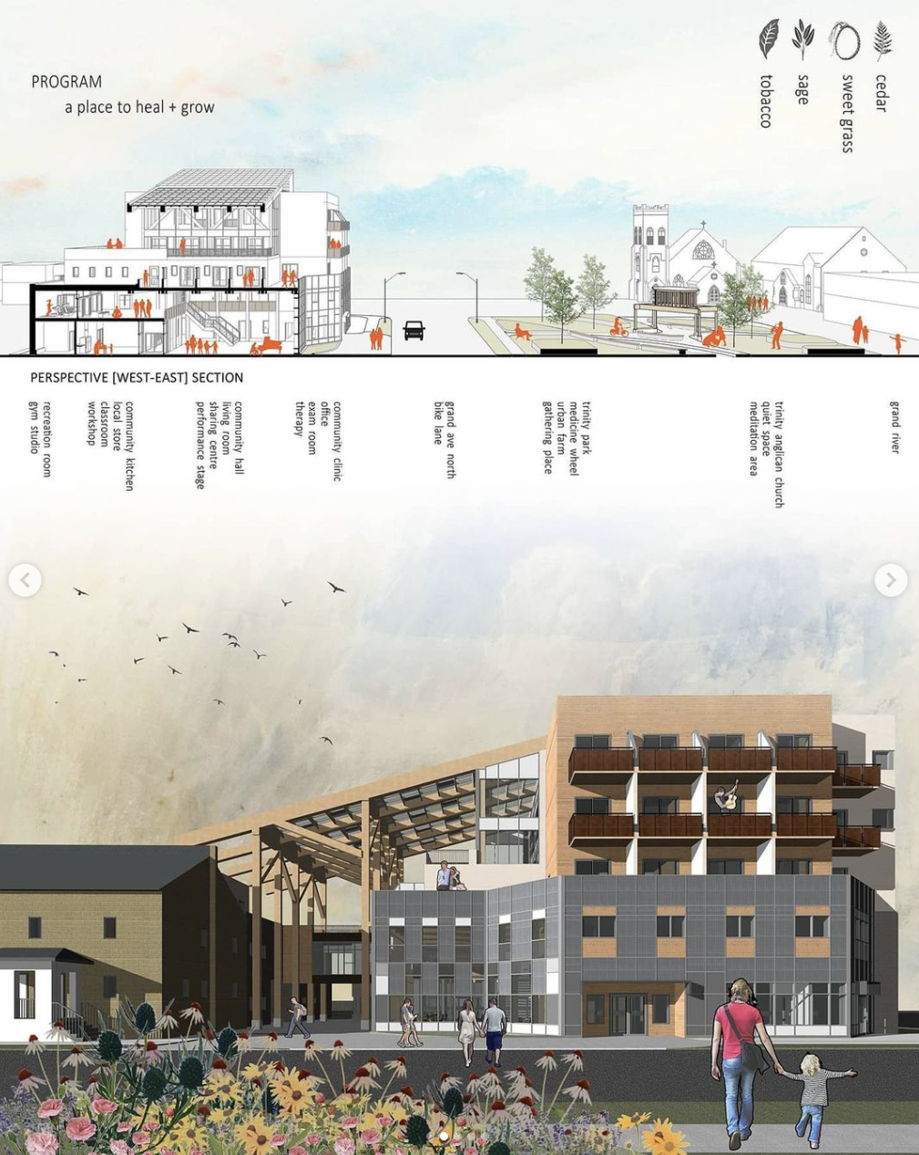
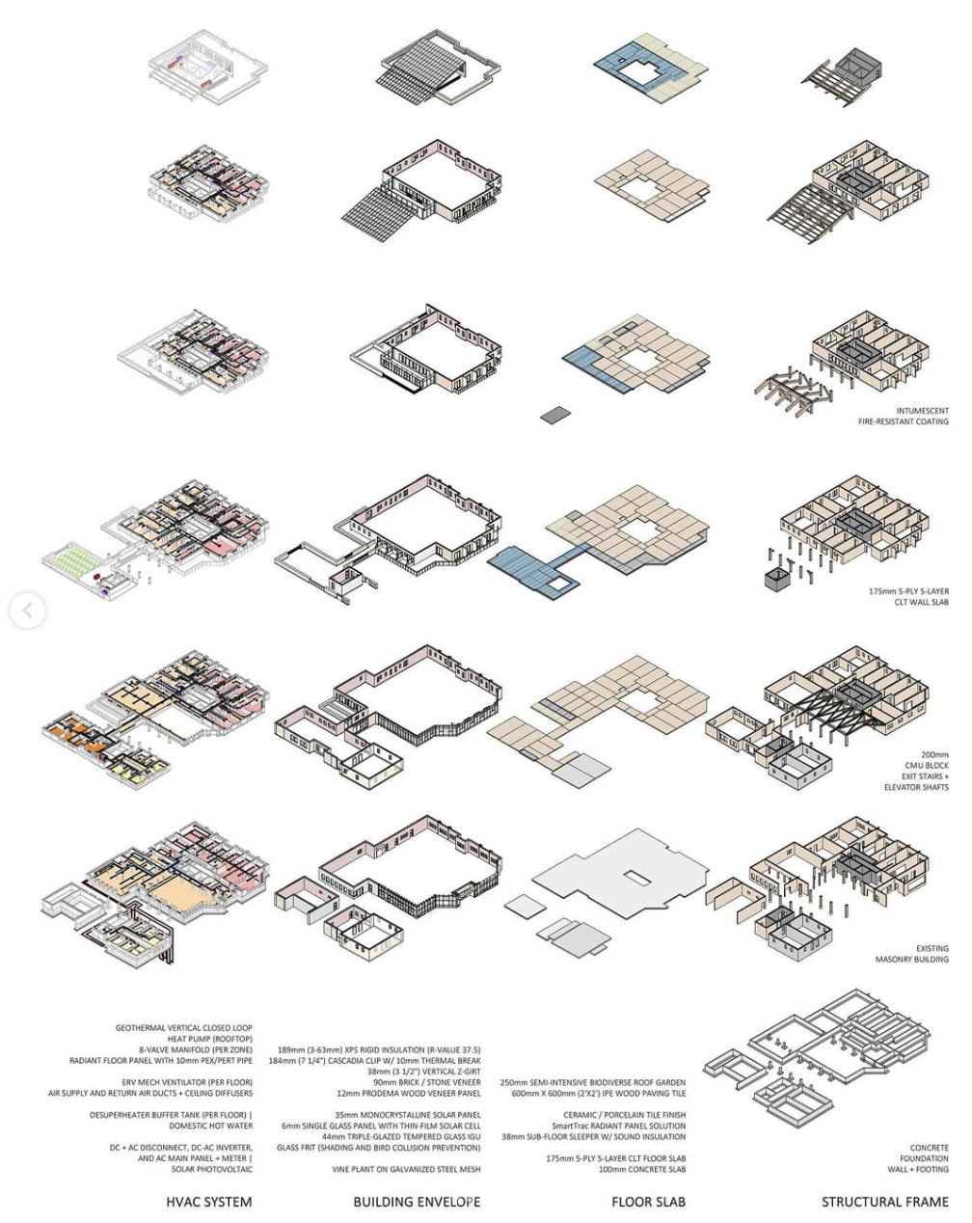
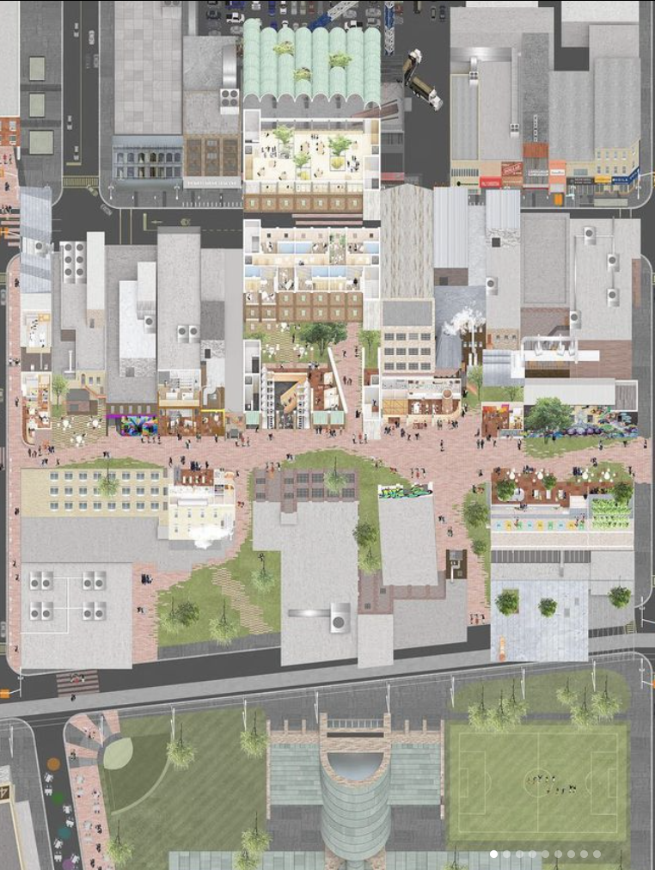
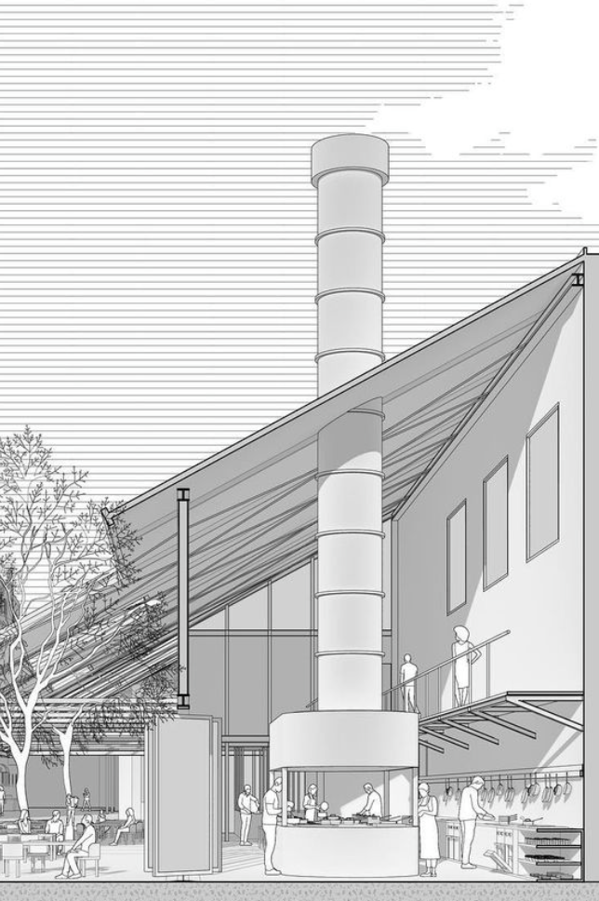
Design Studio
Year 1 Term 1: Technical Design Studio
Graduate work by Carlo Rosel
Year 1 Term 2: Explorative Design Studio
Graduate work by Zihao Wei and Vincent Chuang

Slide 7
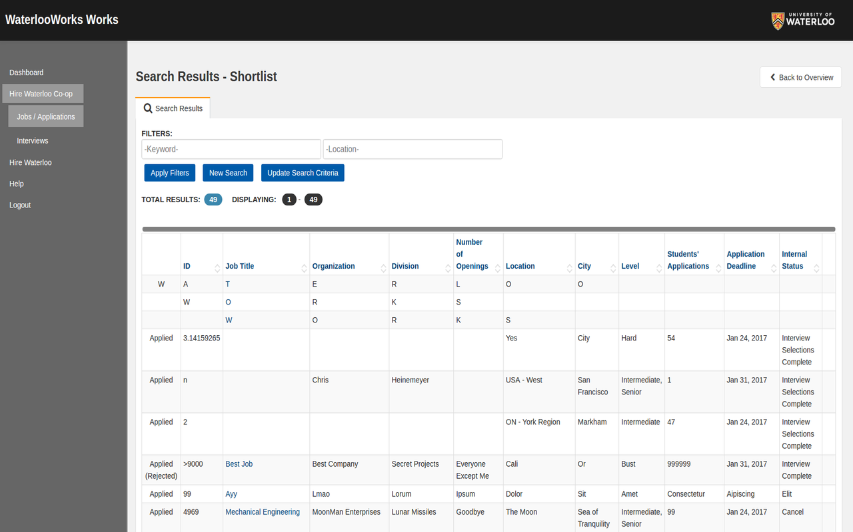







Co-op opportunities at UWSA
Offered to students in the two-year stream (not holding a Bachelor of Architectural Studies degree at University of Waterloo) as an option
For the spring term before your thesis year (4 months)
Hours of work can be counted towards your IAP for licensing
Benefits: rich depth of skills and knowledge, expand your network, increases chances of employment after graduation
Same support system for Waterloo's intensive co-op programs in the bachelor level are available to MArch students!
  Job portal – Waterlooworks
  Job fairs – P4E, etc.
  Centre for Career Development support services

Slide 8
Research Thesis Year at a Glance...
2nd Year
Fall
Up to four courses, including studio
This is where you begin to develop your thesis ideas and concept as the courses help start you in your thesis journey
Winter
Three courses, including one crash course at the end of the term (up to two active courses)
Studio focuses on writing development and design
Spring
One elective course
Students are encouraged to use elective courses to explore areas related to your thesis, and up to 1 elective course can be taken in other departments

Slide 9
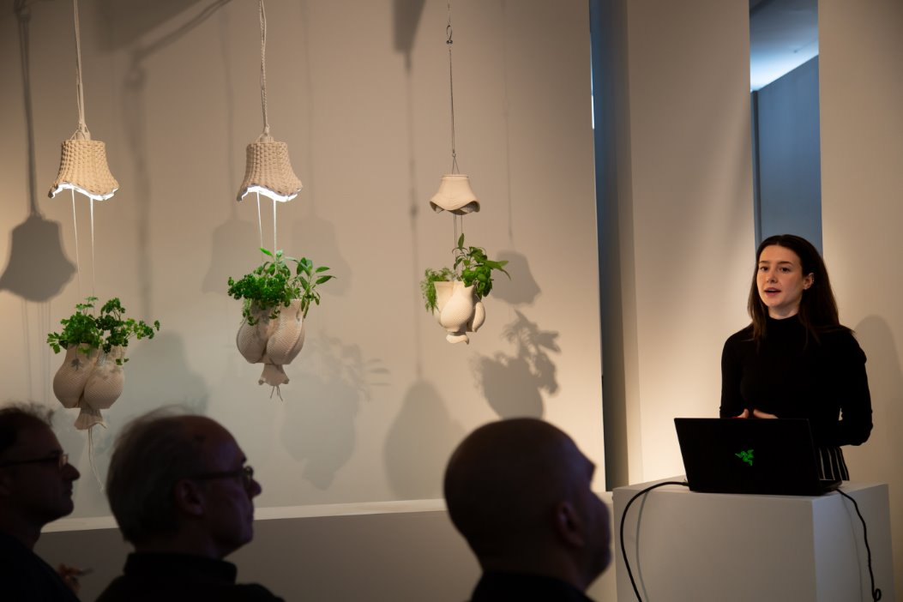
Thesis Committee and Support
Supervisor
During year 2 fall term, you begin to engage in conversations with professors that may be compatible with your topic
You are matched with your supervisor by the end of fall term and begin working with them in the winter
Over 21 members of faculty are eligible for thesis supervision, very tight-knit and supportive!
Committee Member
One professor from the faculty, you choose during the year 2 winter term
Internal Reader
One professor from the faculty, you arrange prior to your defence date with the help of your supervisor
External Reader
An expert in your field of research, arranged by your supervisor
Will have no knowledge of your thesis prior to your defence date

Slide 10
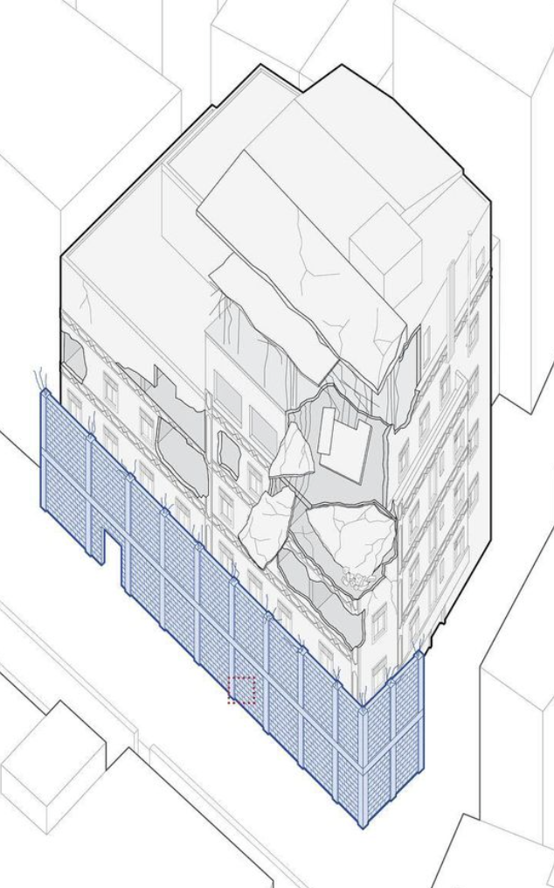
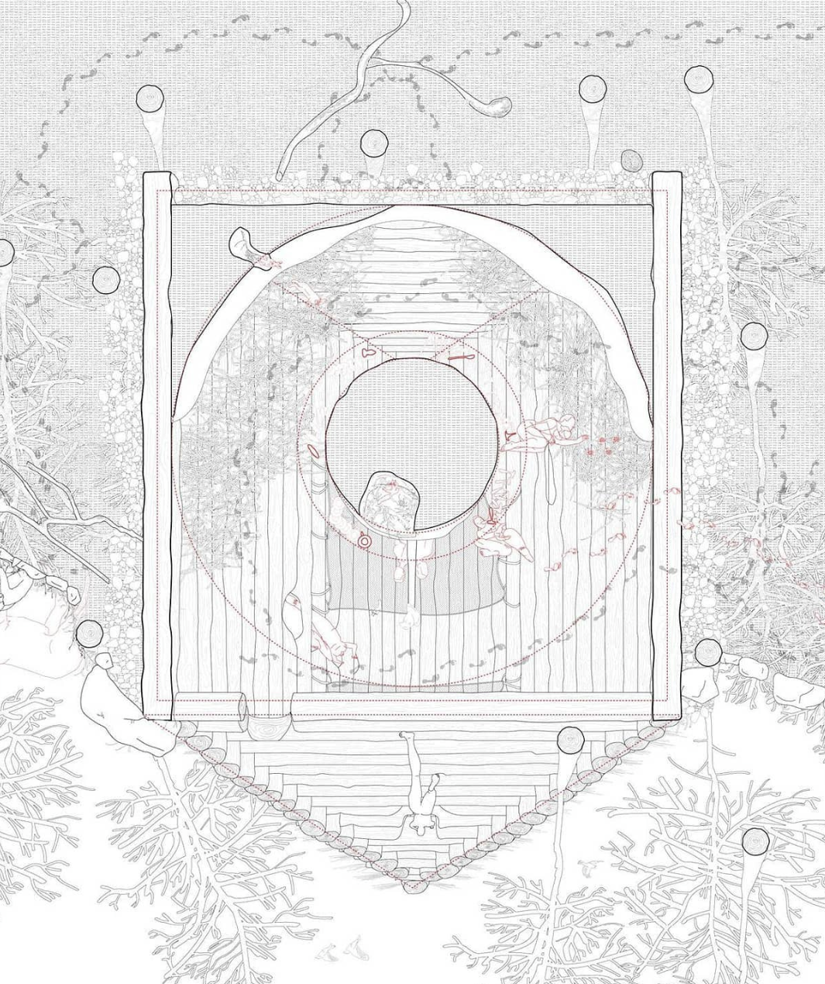
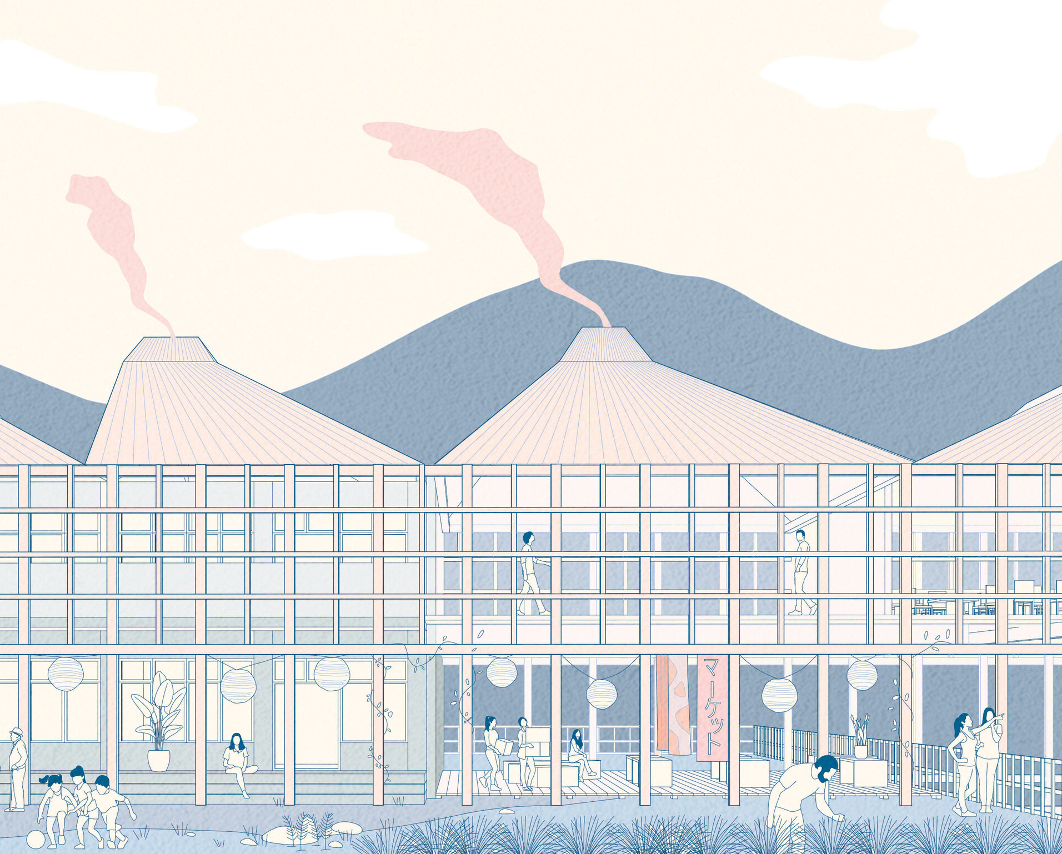
Award-Winning Theses
"Civilian Architectural Responses: How Civilians used Architecture to Survive war" by Omar Ferwati
OAA Guild Medal, RAIC Honour Roll
"The Witch's House" by Vic Mantha Blythe
RAIC Medal, RAIC Honour Roll, Nominee for Canadian Architect Student Award of Excellence
"Finding a New Commons: Re-inhabiting the School in Post-Urban Japan" by Julia Nakanishi
Alpha Rho Chi Medal, RAIC Honour Roll, Nominees for Canadian Architect Student Award of Excellence

Slide 11

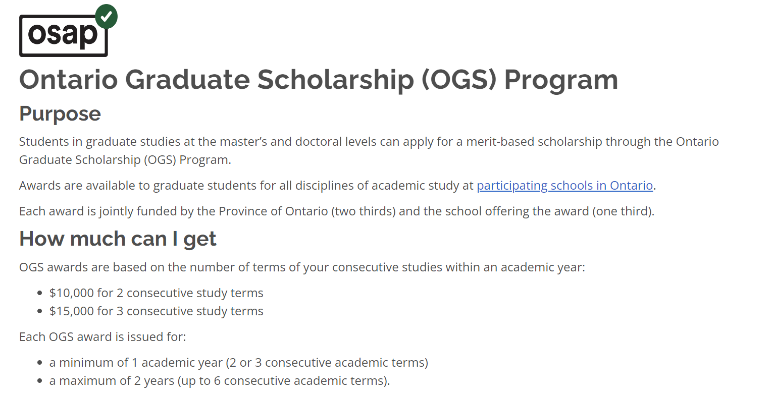
Scholarships
Canada Graduate Scholarship – Master's program
Under Tri-Agency council, $27,000 for 3 study terms
Ontario Graduate Scholarship (OGS)
$15,000 for 3 study terms
Canada Graduate Scholarship – Michael Smith Foreign
Studies Supplement (CGS-MSFSS)
Up to $6,000 for international research travel
UW School of Architecture Grad Office Award Opportunities
Various awards, ranging from $300-$2,000
And so much more...
Tri-Agency Council (CIHR, NSERC, SSHRC)
Ontario Graduate Scholarship (OGS) is under OSAP

Slide 12



Student Associations
The Society of Waterloo Architecture Graduates (SWAG)
Year reps, coordinators and executive roles
Graduate student support for academics, thesis, resource-gathering and student initiatives
GSA-UW
Health & Dental Plan, Housing, TA and RA services
Canadian Architecture Students Associations (CASA)
Undergraduate and graduate student representatives

Slide 13
Applications
Requirements:
Online application form
  Do this first, submit with application fee by January 15, 2025. After 1-2 business days, you will be given access to an online portal to submit other required documents below!
September 28, 2024 (Today)
CASA Cross-Institutional Seminar
Transcripts
  From all post-secondary study, you can use interim transcripts if degree is in progress
Portfolio
  Max 50MB, 8.5 x 11" sheet sizes, other specific instructions available in UWaterloo website
English language proficiency (ELP) score***
  A valid, current (less than two years old) ELP score is required
Reference letters
  Two academic reference letters are preferred
  If necessary, one of the two letters may be from a professional reference
January 15, 2025
Last day to submit applications
Personal statement/Supplemental Information Form
  500-words max statement on your research interests
  Suggested structure:
    Introduction sentence
    What’s the key research question?
    Summarize how your research will contribute to the knowledge in the field
    Explain how you will approach the research question or what new perspective you will investigate
    How are you planning to do the research: experiments? A type of design project? Case studies? This is likely to be the longest sentence.
    Last sentence, what do you hope will be the main impact of your research?
February 1, 2025
Deadline to submit final documents

Slide 14
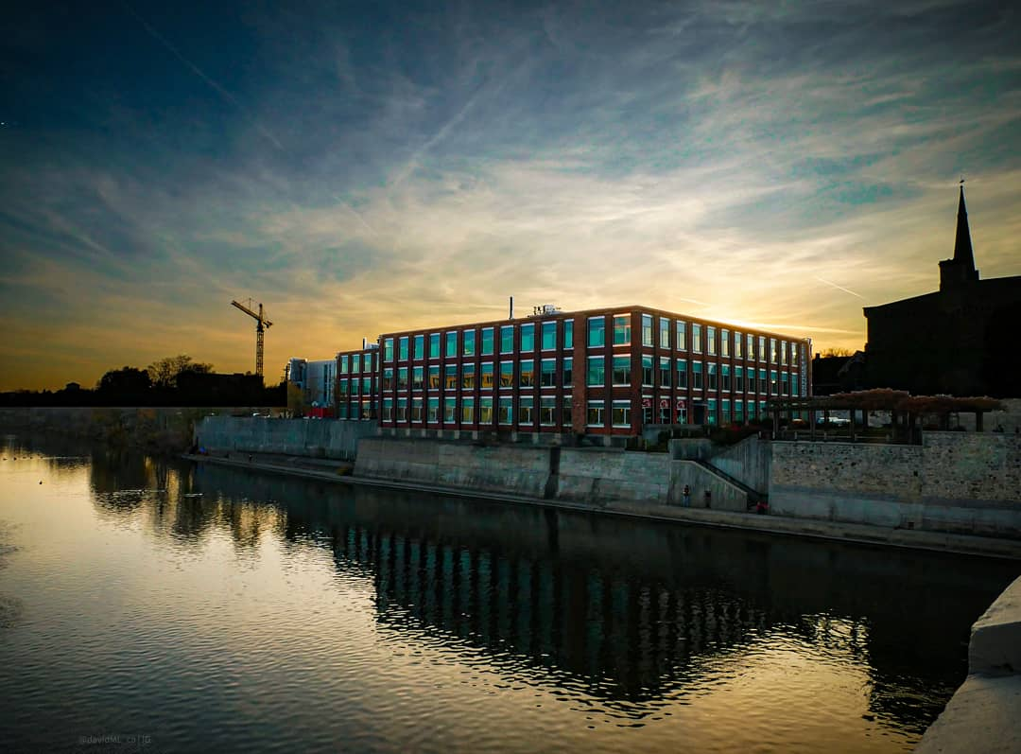

Inquiries on how to apply?
You can reach out to the graduate office counsellor, Mark Anderton at:
archgradoffice@uwaterloo.ca
UWaterloo website with further details on how to apply:
https://uwaterloo.ca/architecture/academic-programs/master-architecture/future-graduate-students

Slide 15
Thank
You

